Slide 1
Creating a Data Visualization using Tableau Public

Slide 2
Starting up the Program

Slide 3
Try 1

Slide 4
Open Data
Notes:
Specify the type of data…a Tableau Data Extract, Microsoft Access, Microsoft Excel, or Text File.

Slide 5
Ingested Data

Slide 6
Dimensions
College
Corresponding Number
Hybrid
ITV
Online
Optional
Other
Tele Class
Tele Course
Total
Web Enhance

Slide 7
The Raw Data in .xl

Slide 8
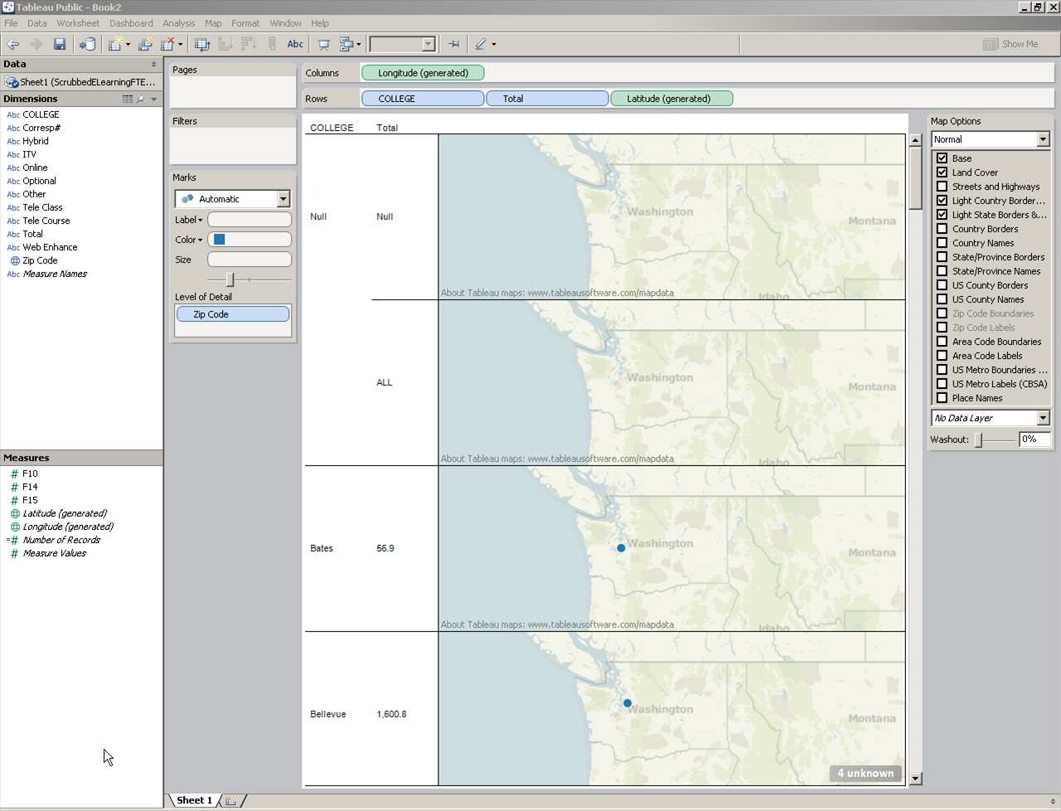
Manually Putting in Zip Codes
Generating latitudes and longitudes

Slide 9
Computing the View Layout

Slide 10
An Initial Map

Slide 11
Adding Map Options Details

Slide 12
Try 2

Slide 13
Postsecondary Tiered Technical State Aid and KBOR Calculated % of System Gap

Slide 14
Simplified Data to College and Gap

Slide 15
Putting the Worksheet in a Dashboard
Drag and drop
May combine multiple data sets and views
Need clear labeling for clarity

Slide 16
Creating an Account (to Save to the Web)

Slide 17
Preview

Slide 18
A Simplified View

Slide 19
Publicly Available and Opened in Browser Window

